Slide 1

AUTOMATED ITINERARY PLANNING
Minor Project Presentation
(Covering Period: June to November 2017)
By
Minal Bhandari (149111757)
Siddharth Bhadri (149111620)
Suyash Khemka (149111136)
Information Technology Department
MANIPAL UNIVERSITY JAIPUR
JAIPUR-303007
RAJASTHAN, INDIA
November 2017

Slide 2
Outline
Introduction
Motivation
Problem Definition
Methodology Used
Implementation and Results
Time Line Chart
Future Work
References

Slide 3
INTRODUCTION
Today most of the people love to travel but traveling is not as simple as choosing destinations randomly and visiting them one by one. What we need is an ITINERARY which is a PLAN that displays how you will get from one point to another and when you will be at each point.
A travel itinerary should effectively manage your TRAVEL TIME to certain numerous attractions while at the same time considering unforeseen circumstances such as TRAFFIC. Thus, time is not wasted.

Slide 4




MOTIVATION
Consider the following scenarios :
Suppose you have 3 destinations to visit and you choose them randomly one by one. Two of them lie on the same route and one on different.
2
1
1
2
3
3
4
4

Slide 5
MOTIVATION
Suppose you reach a destination at 6pm but realise that the visiting hours of that destination is from 3pm to 4pm.
These are some problems which we may face if we travel without a plan. Thus it is important to have an itinerary which saves our time and cost and at the same time considers the visiting hours of destinations, areas currently closed due to construction, etc. which may affect our plan.

Slide 6
PROBLEM DEFINITION
The project aims to design a detailed day-by-day itinerary to travel a city (Jaipur) while considering time, cost, user’s preferences, user’s available time slots, visiting hours of destinations and traffic. Thus by making use of automated planning techniques, the user will be presented with the most optimum 2-3 itinerary plans satisfying all the constraints required.

Slide 7
CASE 1: Visiting most popular destinations
Lets say the user has only one day to travel (11am-6pm) and wants to visit as many popular destinations as possible. Then our application will create 2-3 plans according to which the user can visit about 3-5 popular destinations.
12pm – 1pm
Hawa Mahal
1:15pm – 2:15pm
Bapu Bazar
2:40pm – 3:15pm
Birla Mandir
11 am
Clarks
6 pm
Clarks
4pm – 5pm
Jal Mahal

Slide 8
CASE 2: Visiting user’s preferred destinations
Lets say the user has only one day to travel (11am-6pm) and wants to visit Hawa Mahal, Amer Fort and Jal Mahal. Then our application will create a plan keeping in mind the visiting hours of each destination and the distance covered.
12pm – 1pm
Hawa Mahal
2:30pm – 3:30pm
Amer Fort
11 am
Clarks
3:40pm – 5pm
Jal Mahal
6 pm
Clarks

Slide 9
CASE 3: Visiting most popular destinations
& a user’s specified destination at a specific time.
Lets say the user has only one day (11am-6pm) to travel and wants to visit as many popular destinations as possible. But the user wants to go to Vaishali Nagar between 2-3 pm. Then our application will create 2-3 plans satisfying all the requirements.
12:45pm – 1:30pm
Bapu Bazar
12pm – 12:30pm
Hawa Mahal
11 am
Clarks
2:00pm – 3:00pm
Vaishali Nagar
6 pm
Clarks
4pm – 5pm
Jal Mahal

Slide 10
Methodology Used
ANT COLONY OPTIMIZATION
In the natural world, ants of some species (initially) wander randomly, and upon finding food return to their colony while laying down pheromone trails.
If other ants find such a path, they are likely not to keep travelling at random, but instead to follow the trail, returning and reinforcing it if they eventually find food. Over time, however, the pheromone trail starts to evaporate, thus reducing its attractive strength.
The more time it takes for an ant to travel down the path and back again, the more time the pheromones have to evaporate.

Slide 11
The overall result is that when one ant finds a good (i.e., short) path from the colony to a food source, other ants are more likely to follow that path, and positive feedback eventually leads to all the ants following a single path.
The idea of the ant colony algorithm is to mimic this behavior with "simulated ants" walking around the graph representing the problem to solve.
Using ant colony optimization, we can create an initial set of paths and whichever path satisfies all the time constrains and will visit maximum places will leave more pheromone. Other ants will start taking that direction and will start diverging at different points trying to find a more optimized path. And after a certain number of iterations we will find a few good routes and project the best 2-5 routes to the user.

Slide 12
Nearest Neighbor Technique
The nearest neighbor algorithm was one of the first algorithms used to determine a solution to the travelling salesman problem.
In it, the salesman starts at a random city and repeatedly visits the nearest city until all have been visited. It quickly yields a short tour, but usually not the optimal one.
During lunchtime, using the user’s current location, nearby restaurants will be suggested and after lunchtime Ant Colony Optimization will be continued.

Slide 13
Implementation and Results
The project designs an itinerary containing a list of places to be visited at given timings.
This itinerary is designed using ant colony optimization algorithm which takes into account the time slots in which user is available, user’s preferred type of destinations, the distance between various places, the opening and closing timings of tourist spots and ratings of different destinations.
It is difficult for a person to consider all these factors simultaneously for a comfortable trip. This project makes the job easier and faster so that the user can enjoy his trip.

Slide 14
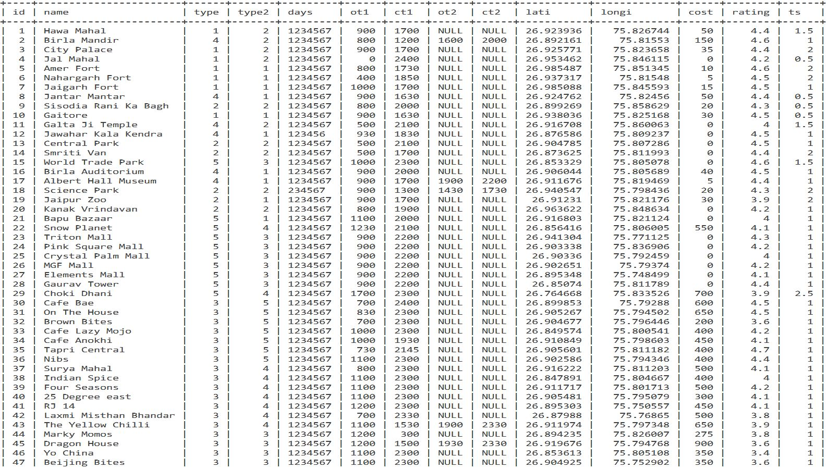
Tourist Destinations in Jaipur

Slide 15
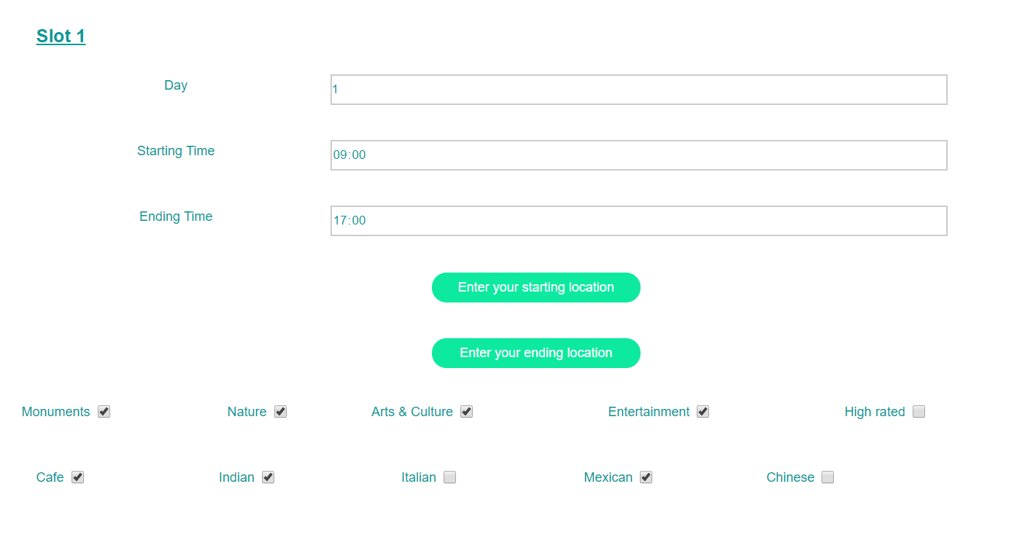
Form Filled by User

Slide 16
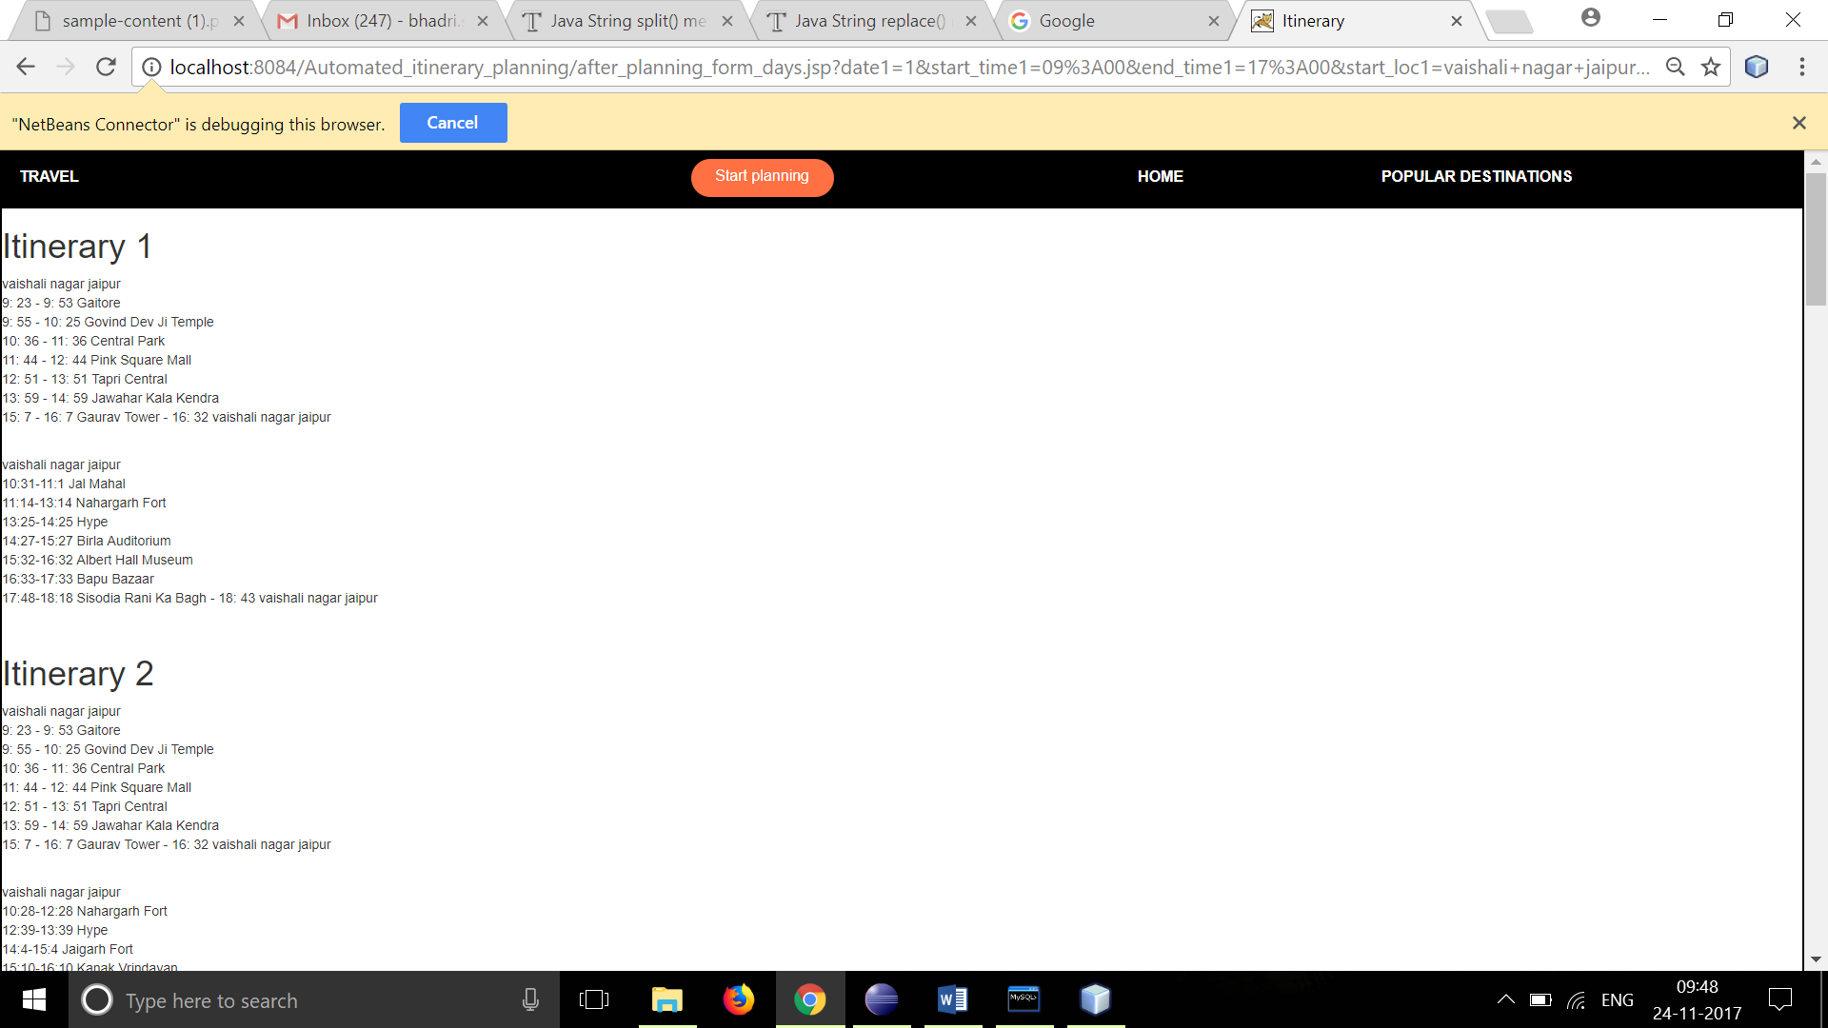
Itinerary Generated

Slide 17
Time Line Chart

Slide 18
Future Work
Some places are mostly preferred by people to visit in the evening such as Birla Mandir and thus a person would most probably like to visit Birla Mandir in evening.
But the itinerary generation has not been done considering this factor because of insufficient data available regarding the same. Thus popular visiting hours of places can be collected and thus factored while designing the itinerary.

Slide 19
This project only covers one city Jaipur. It can be extended to more cities and further to an entire country.
The itinerary can be dynamic.
Suppose after an itinerary is created and user starts travelling as per the created plan.
But after reaching a specific location defined in the itinerary, the user spends more than the average time spent at that place. Then he will specify the time at which he left that destination and then the rest of the itinerary will be changed accordingly.

Slide 20
References
[1] S.B. Roy, G. Das, S. Amer-Yahia, and C. Yu, “Interactive Itinerary Planning,” Proc. IEEE 27th Int’l Conf. Data Eng. (ICDE), pp. 15-26, 2011.
[2] Kwan Hui Lim, “Recommending and Planning Trip Itineraries for Individual Travellers and Groups of Tourists”, Department of Computing and Information Systems, The University of Melbourne, Australia, 2016
[3] Popular tourist spots in Jaipur, tripadvisor, “https://www.tripadvisor.in/”
[4] Jaipur tourism, Ixigo, “https://www.ixigo.com/”
[5] Google Maps APIs, “https://developers.google.com/maps/”
[6] Bootstrap, “http://getbootstrap.com/”
[7] Ant Colony Optimization,” https://en.wikipedia.org/wiki/Ant_colony_optimization_algorithms”
[8] Itinerary Planner, inspirock, “https://www.inspirock.com/”

